Slide 1
Introduction to Procurement:
Alternative Delivery Methods for Construction
Sandy Hellums-Gomez
Sandy.gomez@huschblackwell.com
State Bar of Texas
Government Law Roadshow Amarillo
January 10, 2020

Slide 2
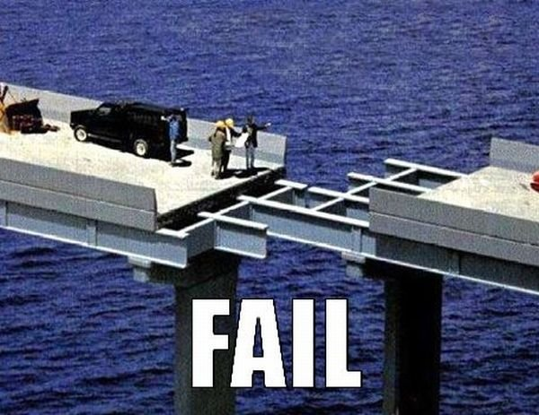
Construction Procurement

Slide 3
Construction Procurement
Complex Projects
Lots of $$$
Highly Visible
Multiple additional regulations
Engaged vendors

Slide 4
The Players
Owner—Governmental Entity
Program Manager—Internal or External
Architect
Contractor
Sub-Contractors

Slide 5
Procurement Exceptions
Is it a sole source?
Items available only from a single provider
Monopolies
Utilities
Patent, copyright
Films, manuscripts, or books
Captive replacement parts
If any of these apply, use your Sole Source form
Is it an emergency?
Immediate purchase required
Destroyed, severely damaged, or experiences a major unforeseen operational or structural failure
Board determines delay would prevent or substantially impair
Classes or essential school activities
If any of these apply, use your Emergency Purchase form
Is it a professional service?
Statute – Govt. Code Chapter 2254
Applies to accounting, architects, surveying, medicine, optometry, engineering, nursing, appraisals
Common Law
Predominantly mental or intellectual, rather than physical or manual skills
Require years of education and service to attain competence and call for a high order of intelligence, skill, and learning AND
Widely accepted standards of required study or specified attainments in a special knowledge as distinguished from skill
If any of the below apply, use an RFQ
Can you use an interlocal agreement?
Allows purchasing through other entity
Agreement must have:
Authorization by the governing bodies
State purpose, terms, rights, and duties
Specify payment from current revenues
Provide fair compensation
Is it construction?
Utilize construction method under Chapter 2269 of Texas Govt. Code
If none of these, use one of the following methods
Request for proposal
Competitive sealed proposals
Bid

Slide 6
Construction Procurement
Governed by Texas Government Code § 2269
Consolidation of various procurement provisions
But what is construction?

Slide 7
Professional Services
Selection Process for Architect, Engineer, or Surveyor
  Most highly qualified provider on the basis of demonstrated competence and qualifications
  May then negotiate a fair and reasonable price
  Cannot Consider Price before Selection

Slide 8
Professional Services
Program Manager
  Oversees and manages several projects;
  Compared to a Project or Construction Manager that is responsible for a single project
  Includes oversight of all project participants:
    ARCHITECTS
    CONTRACTOR
    SUBCONTRACTOR

Slide 9
Professional Services
Program Manager
  Is it a professional service:
    Usually has licensed professional;
    Responsible for oversight of professionals;
    Mental not physical job
  Is it a Construction Manager-Agent:
    Usually has licensed professional;
    Responsible for oversight of professionals;
    Mental not physical job.

Slide 10
Professional Services
Construction Manager-Agent Provides (§ 2269.201)
  Provides consultation or administrative services during the design and construction phase
  Manages multiple contracts with various construction prime contractors
  Provides administrative personnel
  On-site management
  Acts as a fiduciary for the Owner

Slide 11
Professional Services
Construction Manager-Agent Cannot (§ 2269.201)
  Self-perform any work
  Be part of a construction subcontract
  Provide bonds

Slide 12
Professional Services
Construction Manager-Agent (§ 2269.201)
  BUT
  Must have an architect or engineer selected prior to selection to prepare documents “for the project”;
  May provide equipment necessary to perform duties
  More of a project manager than program manager

Slide 13
Professional Services
Construction Manager-Agent (§ 2269.201)
  Selected like an architect or engineer under § 2254

Slide 14
Professional Services-Architect
Request for Qualification Process
  Similar to a Request for Proposal, but without price
  No specifics in the statute, but best practices and local policies dictate a selection process
  Standard procedures apply to RFQ
    Advertising
    Pre-Submittal Meetings
    Establish Criteria
    Pre-Planning

Slide 15
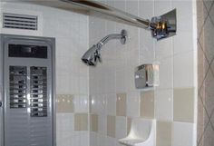
Construction Services – Chapter 2269

Slide 16
Public Works
Tex. Govt. Code 2269.001
Constructing
Altering
Repairing
Public Building
Building or Construction
Tex. Labor Code § 406.096(e)(1)
Erecting or preparing to erect a structure
Remodeling, extending, repairing, or demolishing a structure
Otherwise improving real property through similar activities
Payment and Performance Bond Required
Tex. Gov’t Code § 2253
Same definition as § 2269
Applies to projects over $25,000 (payment) and $100,000 (performance)
Engineer Required
Tex. Occ. Code § 1001.053
Involves mechanical or electrical engineering and costs more than $8,000
Does not involve mechanical or electrical engineering and costs more than $20,000
Public health, welfare, or safety involved
Architect Required
22 Tex. Admin. Code § 1.212
New building greater than $100,000
Existing building removal, relocation, or addition of walls, partitions, or exits exceed $50,000
Prevailing Wages Required
Tex. Gov’t Code § 2258
Construction of a public work, including a building, highway, road, excavation and repair work or other project development or improvement, paid for in whole or in part from public funds.
Complexity and Purpose of the Project
Construction or repairing indicate structural work
Fixture are items affixed to the building permanently impacting it
Construction is not main purpose of contract
Not for services, supplies, or equipment

Slide 17
Construction Services – Chapter 2269
What is a Delivery Method?
  Defines relationship of the Players
  Allocates Risk
What Methods are available?
  Competitive Bidding
  Competitive Sealed Proposal
  Construction Manager-Agent
  Construction Manager-at-Risk
  Design-Build
  Job Order Contracting

Slide 18
Construction Services – Chapter 2269
Which Method provides Best Value?
  Factors:
    Schedule
    Phasing
    Complexity
    Site Considerations
    Value Engineering

Slide 19
Construction Services – Chapter 2269
A public works contract is a contract for constructing, altering, or repairing a public building or carrying out or completing any public work.
A governmental entity must advertise or publish notice of requests for bids, proposals, or qualifications
For a contract entered into by a governmental entity under a method provided by Chapter 2269, the governmental entity must publish notice of the time and place the bid or proposal or request for qualifications will be received and opened.

Slide 20
Evaluating Bids
When awarding construction contracts under Chapter 2269, a governmental entity may consider:
    price;
    bidder’s experience and reputation;
    quality of the bidder’s goods or services;
    impact on the ability of the governmental entity to comply with rules relating to historically underutilized businesses;
    bidder’s safety record;
    bidder’s proposed personnel;
    whether the bidder’s financial capability is appropriate to the size and scope of the project; and
    any other relevant factor specifically listed in the request for bids, proposals, or qualifications.

Slide 21
Competitive Sealed Proposals
Entity selects architect and develops designs
Once design documents are complete solicit sealed proposals
Selection based on price + other factors

Slide 22
Competitive Sealed Proposals
Cons
  No design phase assistance
  Longer schedule duration
  Price not established until design complete
  Adversarial relationship between contractor/architect
Pros
  Selection flexibility
  Defined project scope
  Single point of responsibility for construction

Slide 23
Competitive Sealed Proposals
Entity requests proposals, ranks the bidders, negotiates, and then contracts with a general contractor for the construction, rehabilitation, alteration, or repair of a facility
Entity must select the vendor that submits the proposal that offers the best value for the governmental entity based on the selection criteria in the request for proposal and the weighted value for those criteria in the request for proposal its ranking evaluation

Slide 24
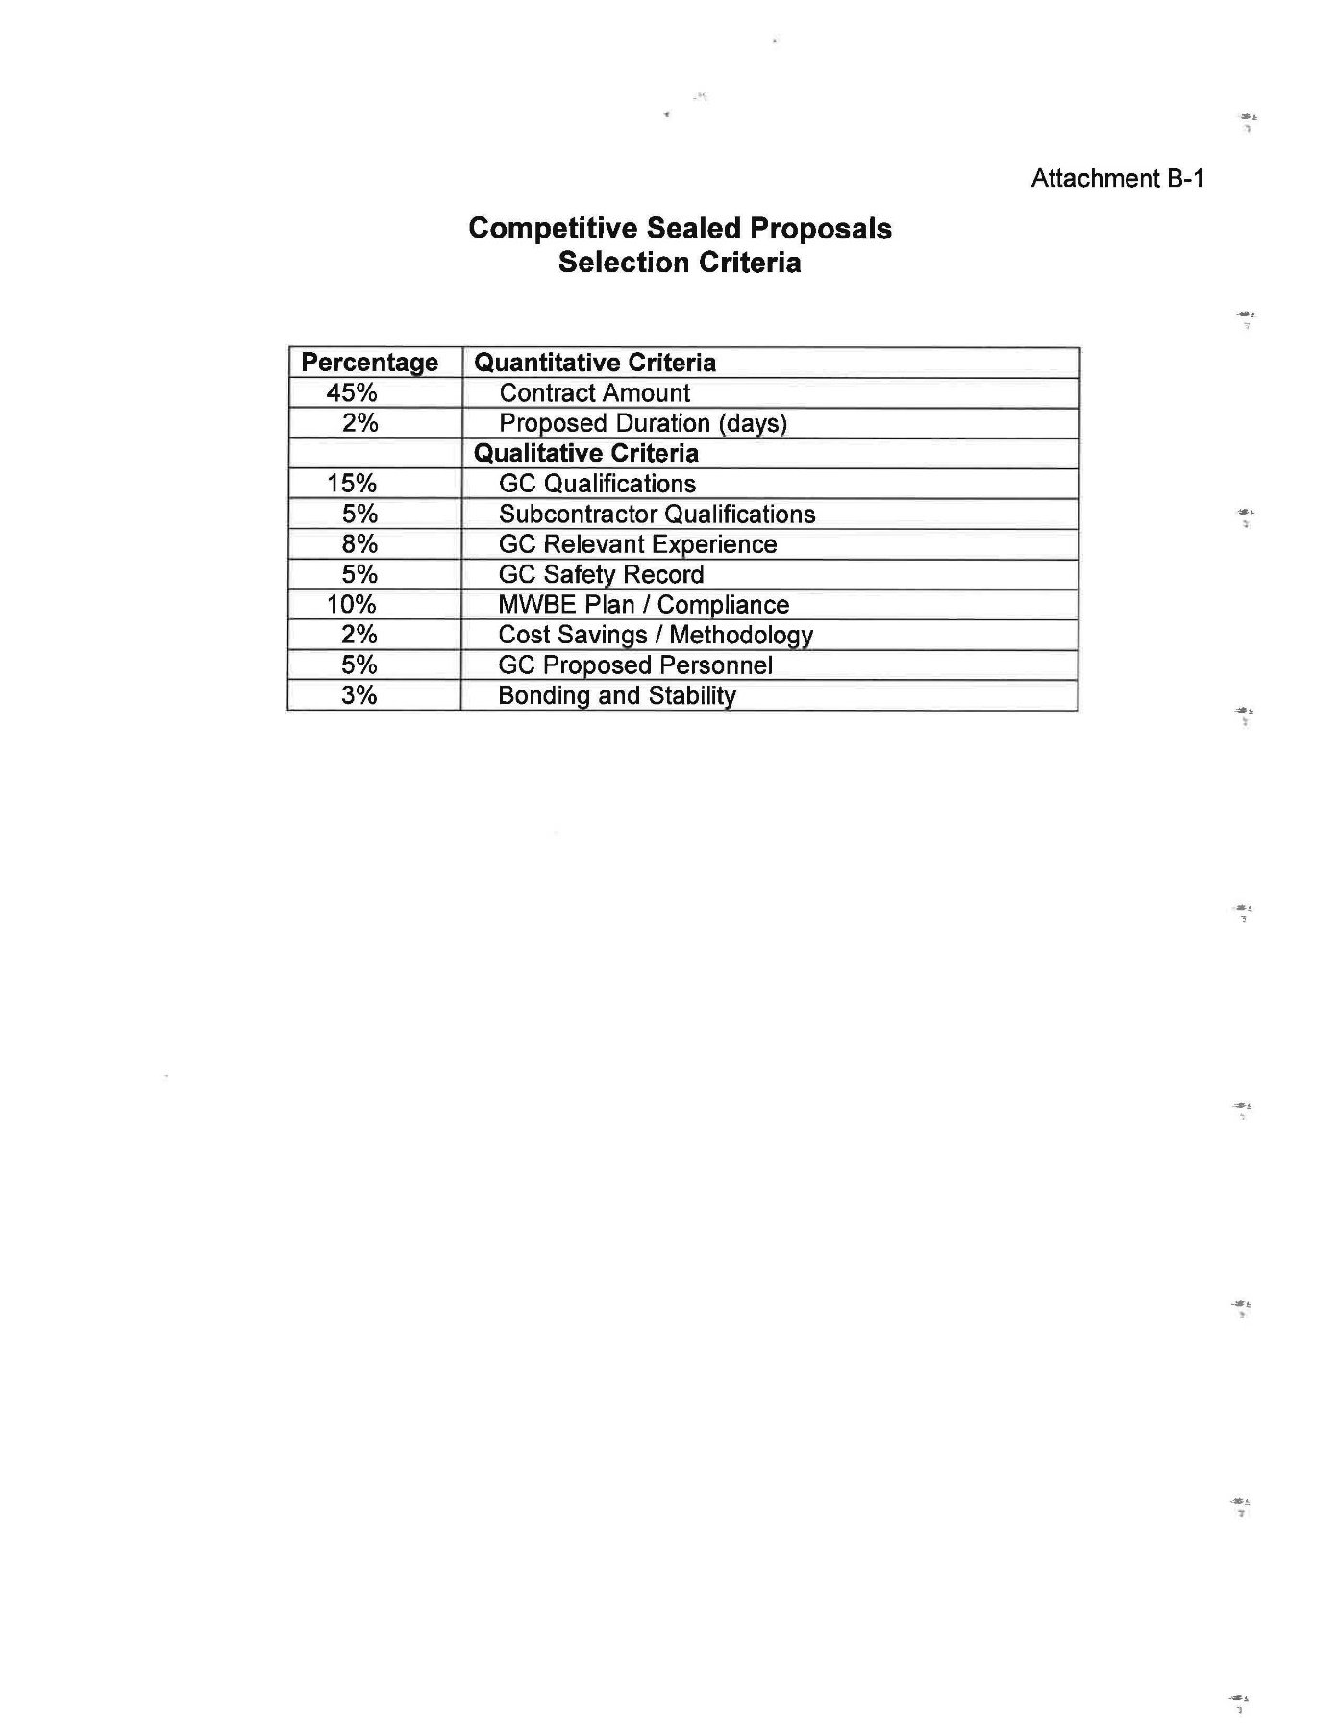
Competitive Sealed Proposals

Slide 25
CSP – Negotiation
After selecting a vendor, the entity must first attempt to negotiate a contract with the selected bidder.
The Owner and its architect or engineer may discuss with the selected bidder options altering the scope or time of the project as well as altering the price due to such a change.
If the Owner is unable to negotiate a satisfactory contract with the selected bidder, the Owner must, formally and in writing, end negotiations with that bidder and proceed to the next bidder in the order of the selection ranking until a contract is reached or all proposals are rejected.

Slide 26
Construction Manager At Risk
CMAR serves as general contractor
Provides pre-construction services
Provides design phase consultation
Helps evaluates costs, schedule, alternative designs
Single point of responsibility for subcontractors

Slide 27
Construction Manager At Risk
Entity contracts with an architect or engineer for design and construction phase services and contracts separately with a construction manager-at-risk (CMAR) to serve as the general contractor and to provide consultation during the design and construction, rehabilitation, alteration, or repair of a facility
Entity may either use a one- or two-step process

Slide 28
Construction Manager At Risk
Pros
  Selection flexibility
  Design phase assistance
  Single point of responsibility
  Team concept
  Faster schedule delivery
  Change flexibility
Cons
  Difficult to evaluate GMP

Slide 29
CMAR – One-step Process
If selected, Entity must prepare a single request for proposals
Entity may request proposed fees and prices for fulfilling the general conditions of the project

Slide 30
CMAR – Two-step Process
Entity must prepare an initial RFQ that includes:
    statement as to if selection process is a one- or two-step;
    general information on the project site, project scope, schedule, selection criteria and the weighted value for each criterion, and estimated budget and the time and place for receipt of the proposals or qualifications;
    other information that may assist entity in selection of CMAR
Entity cannot request fees or prices in step one, but instead narrow down the bidders based on their responses to RFQ.
In the second step, the Entity may request that a maximum of five bidders, who have been selected solely on the basis of their qualifications, provide more information, including their fees and prices

Slide 31
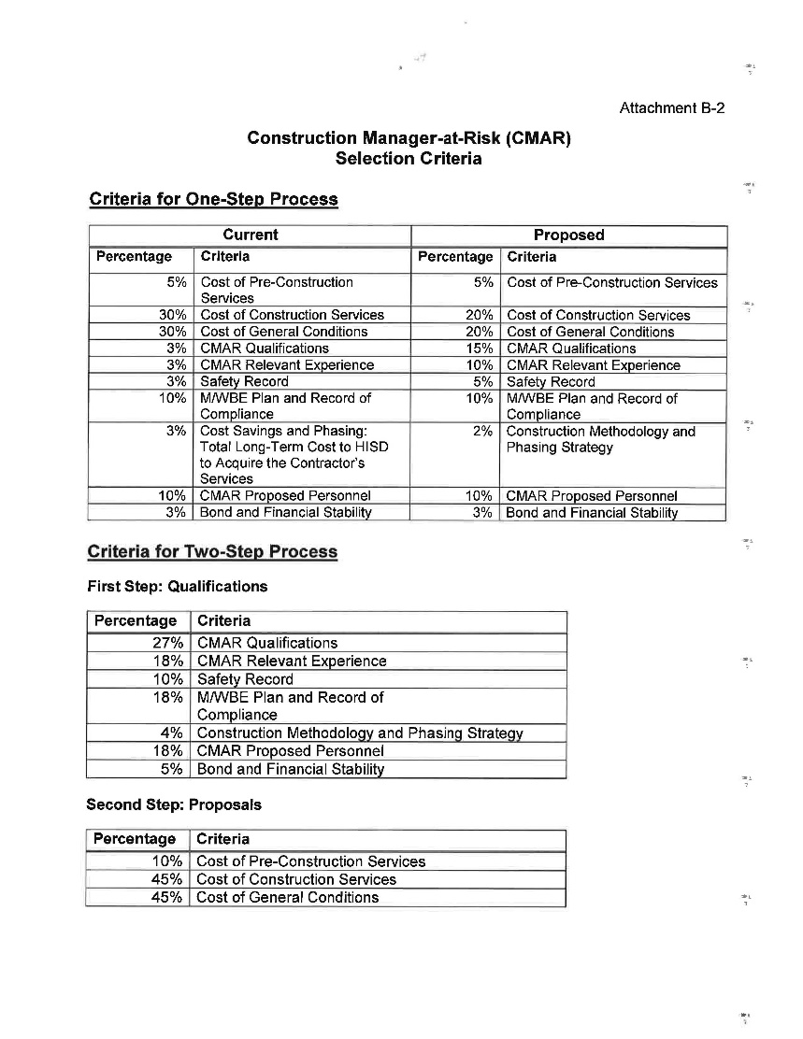
CMAR – Two-step Process

Slide 32
CMAR – Selection and Negotiation
The Owner must select the vendor that submits the proposal that offers the best value for the entity based on the published selection criteria and on its ranking evaluation.
Much like CSP, after selecting a vendor, the Owner must first attempt to negotiate a contract with the selected bidder.
If the Owner is unable to negotiate a satisfactory contract with the selected bidder, the entity must, formally and in writing, end negotiations with that bidder and proceed to the next bidder in the order of the selection ranking until a contract is reached or all proposals are rejected.

Slide 33
CMAR – GMP Process
CMAR responsible for selection of subcontractors in compliance with law
May self-perform work if also follow bid requirements
Once all bids are collected presents a proposed price
Entity then negotiates the price with the CMAR
If unable to agree, may terminate CMAR contract

Slide 34
CMAR – GMP Process
Items to look for
  Confirm proper fee
  Proper format
  Bonding/Insurance
  Confirm no charges for prohibited items
  Self-Performance/Related Entities
  Assumptions & Clarifications

Slide 35
Design-Build
Single entity provides architecture and construction services
Used in a few instances
  HVAC
  Field Improvements

Slide 36
Design-Build
Pros
  Selection flexibility
  Single point of responsibility
  Faster
  Team concept
Cons
  No checks and balances
  Potential adversarial relationship

Slide 37
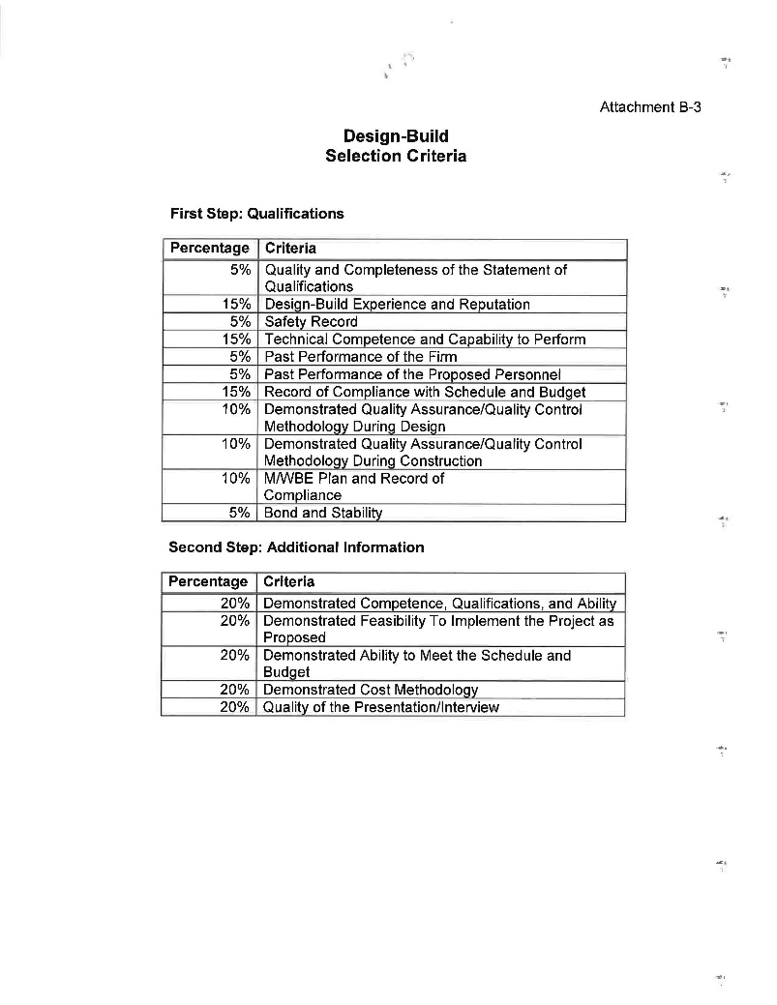
Design-Build

Slide 38
Design-Build
Requires an Independent A/E to represent Owner
RFQ Process Must Include
  Project site
  Project scope
  Budget
  Special systems
  Selection criteria
  Weighted criteria

Slide 39
Design-Build
RFQ Process Must Include
  Legal description of site
  Survey information
  Interior space requirements
  Special material requirements
  Material quality standards
  Concept requirements
  Cost or budget estimates

Slide 40
Design-Build
Evaluation Requirements
  Experience
  Technical competence
  Capability to perform
  Past performance
  Other appropriate factors
  No cost or price-related information

Slide 41
Design-Build
Two-Step Process
  Qualify up to five responders
  May request additional information
    Demonstrated competence
    Safety and long-term durability
    Meeting schedules
    Costing methodologies
    Does not include a GMP or overall price

Slide 42
Design-Build
Provide final plans
Pricing is not specified in the statute

Slide 43
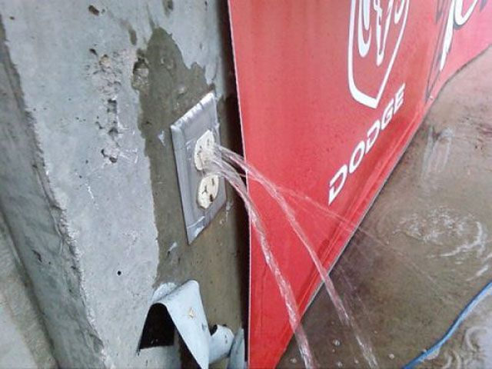
Job Order Contracting

Slide 44
Job Order Contracting
Different from the other “Delivery” Methods
Not a type of company
“JOCs” are contractors-general or trade
JOC describes a contracting method
Open ended with no guaranteed work
Indefinite delivery, indefinite quantity

Slide 45
Job Order Contracting
Benefits of JOC
  Fast response
  Reduced changes
  Reduced “up-front” time
  Incentive for high performance
  Smaller firms

Slide 46
Job Order Contracting
When should a JOC be used?
  When is it the “best value”?
  “maintenance, repair, alteration, renovation, remediation, or minor construction of a facility when the work is of a recurring nature but the deliver times, type, and quantities of work required are indefinite
  Awarded on predescribed and prepriced tasks

Slide 47
Job Order Contracting
Selection Process
  Competitive Sealed Proposals
  Specify a unit price book and line items or
  Coefficient

Slide 48
Job Order Contracting
Limitations
  Over $500,000 Job Order must be board approved
  Must establish an overall aggregate contract price
  More than one vendor allowed
  Two year terms with 3 year renewal

Slide 49
Other Considerations
Performance and Payment Bonds
Safety and Security
  Badging
  Drug-Testing
  Background Checks
Prevailing Wage Rates
  Local v. Davis-Bacon
Labor Compliance
  E-Verify

